Slide 1
Instagram User Analytics
BY:AMRUTH

Slide 2
Project Description
Instagram User Analytics is project that is to gain a good insight on Instagram functionalities
like asking questions to know whether the app satisfies the user interest
Or what needs to be improved to gain wide range of attention across the world
This continuous questioning right from the day of deployment of the product helps the investors, marketing team, development team and some others to gain a great insight on their product

Slide 3
Approach
One step at a time
Frame the question to be analysed and break it into step by step to understand and analyse it more clearly and precisely
Create a database named as Instagram
Create tables such as – (likes, users, posts, comments etc)
And frame a query using simple SQL which can collect the required information from the database

Slide 4
Tech-Stack Used
I used phpMyAdmin as a server to store the data base and I have used it because of my earlier exposure and hands on training
MySQL is the language used for querying from the database

Slide 5
Insights
To work with such datasets was a great experience
Where I started project by establishing such an ideas on how to approach the questions so that it can be solved with great deal of comfort !
To talk about SQL I understood how it can give result in a simplified way so that from very large datasets we can find a simple solution to big problem

Slide 6
Result
I found how interesting it is to work with data by using skills like SQL
We can manage the data by more defined way and found the way how can I use my skills to analyse any such app/product and give a great insight to the investors or other teams

Slide 7
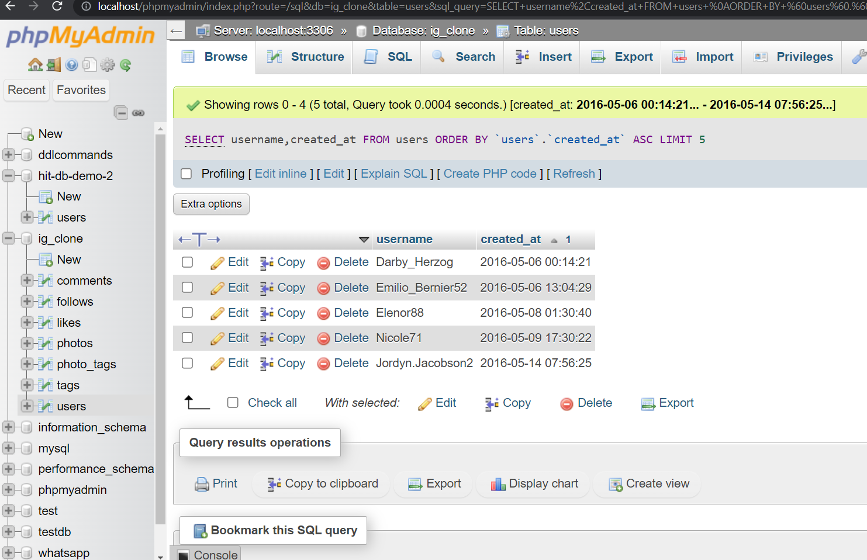
OVERVEIW Find the 5 oldest users of the Instagram from the database provided
SELECT * FROM users ORDER BY created_at LIMIT 5

Slide 8
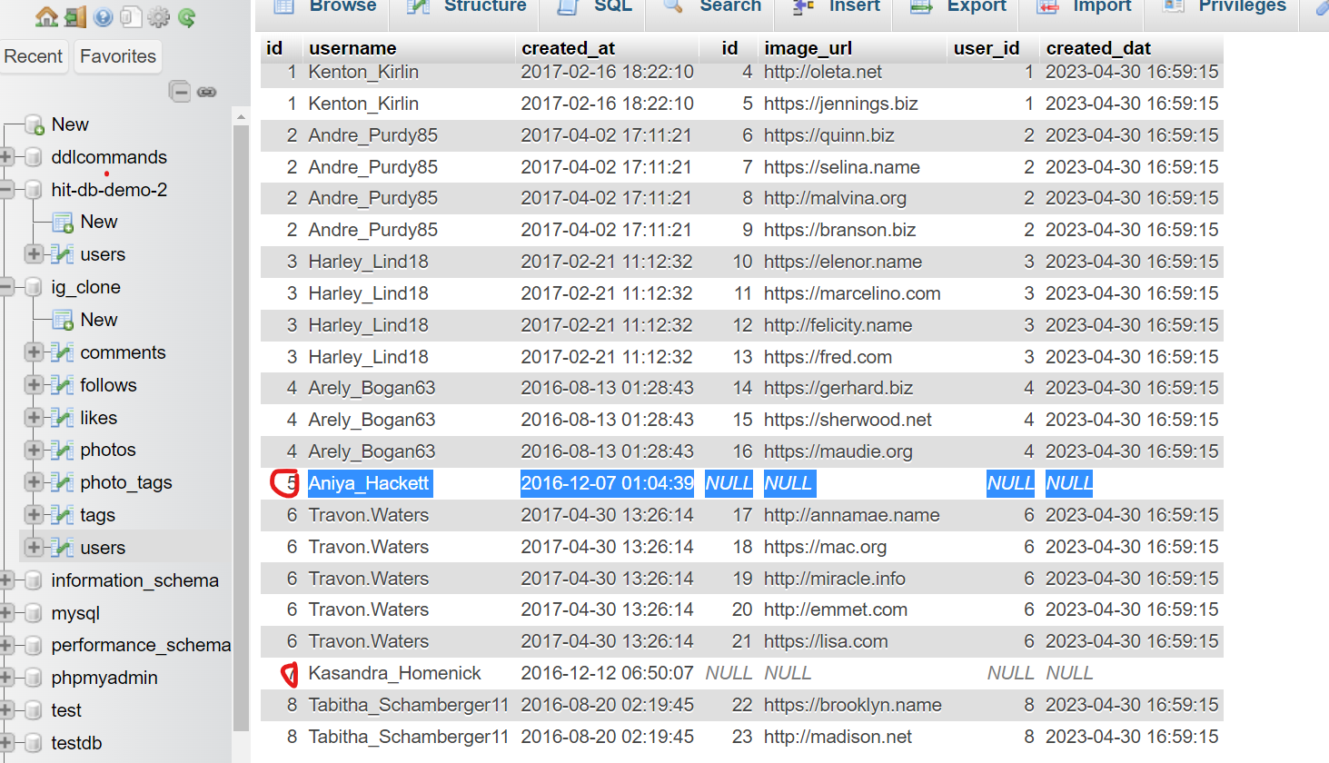
Find the users who have never posted a single photo on Instagram
SELECT * FROM (SELECT u.id,u.username,p.image_url FROM `users` u LEFT OUTER JOIN photos p ON u.id = p.user_id UNION SELECT u.id,u.username,p.image_url FROM `users` u RIGHT OUTER JOIN photos p ON u.id = p.user_id) A WHERE image_url IS NULL;

Slide 9
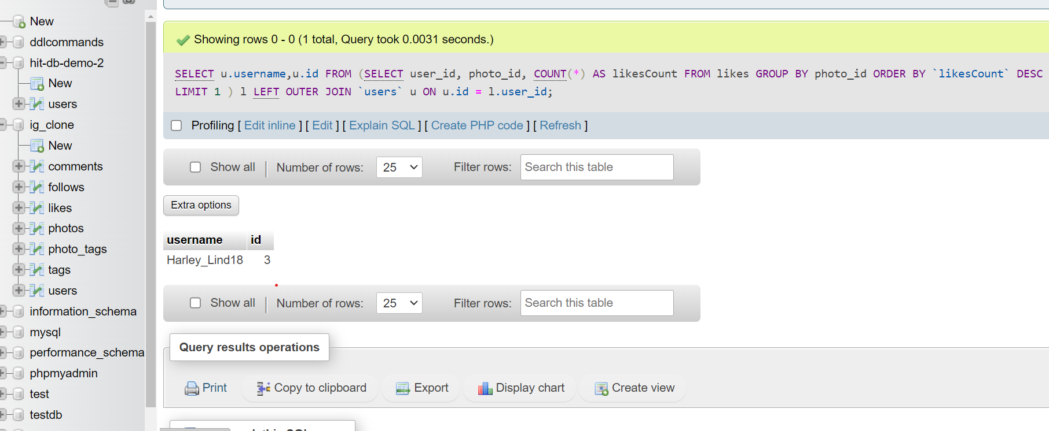
Identify the winner of the contest and provide their details to the team
SELECT u.username,u.id FROM (SELECT user_id, photo_id, COUNT(*) AS likesCount FROM likes GROUP BY photo_id ORDER BY `likesCount` DESC LIMIT 1 ) l LEFT OUTER JOIN `users` u ON u.id = l.user_id;

Slide 10
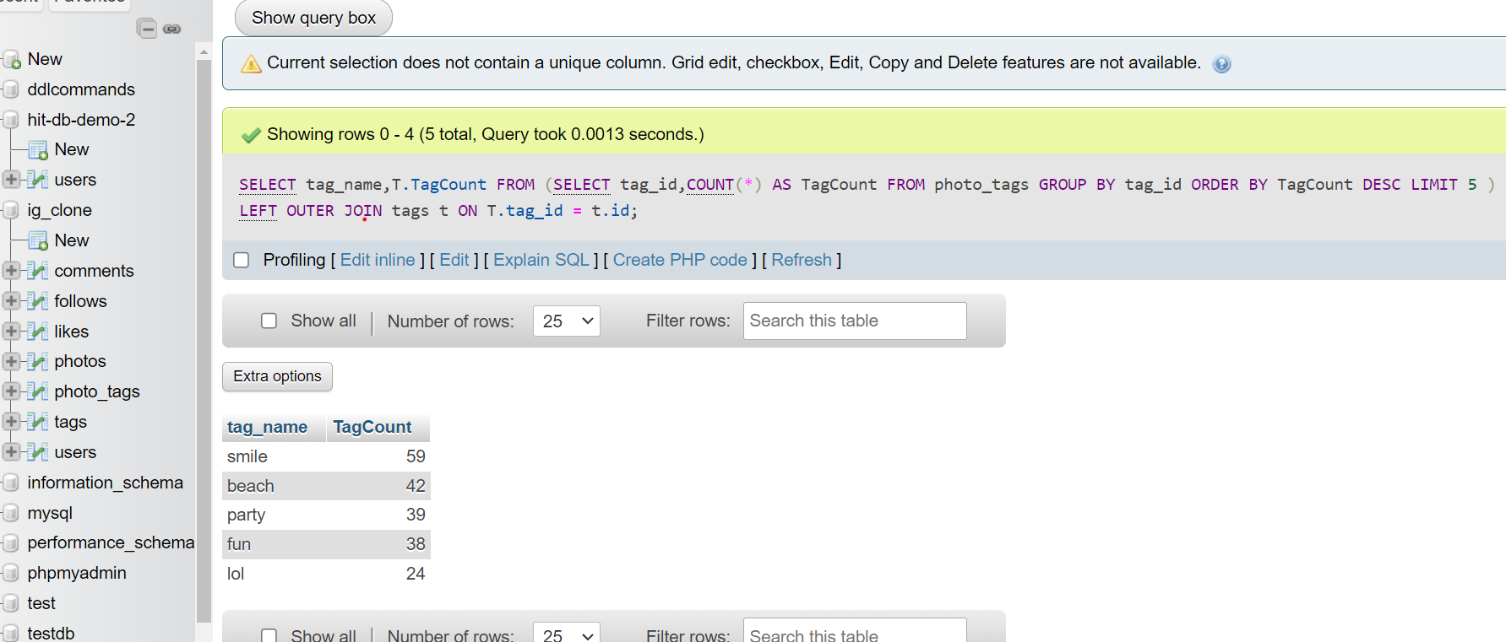
Identify and suggest the top 5 most commonly used hashtags on the platform
SELECT tag_name FROM (SELECT tag_id,COUNT(*) AS TagCount FROM photo_tags GROUP BY tag_id ORDER BY TagCount DESC LIMIT 5 ) T LEFT OUTER JOIN tags t ON T.tag_id = t.id;

Slide 11
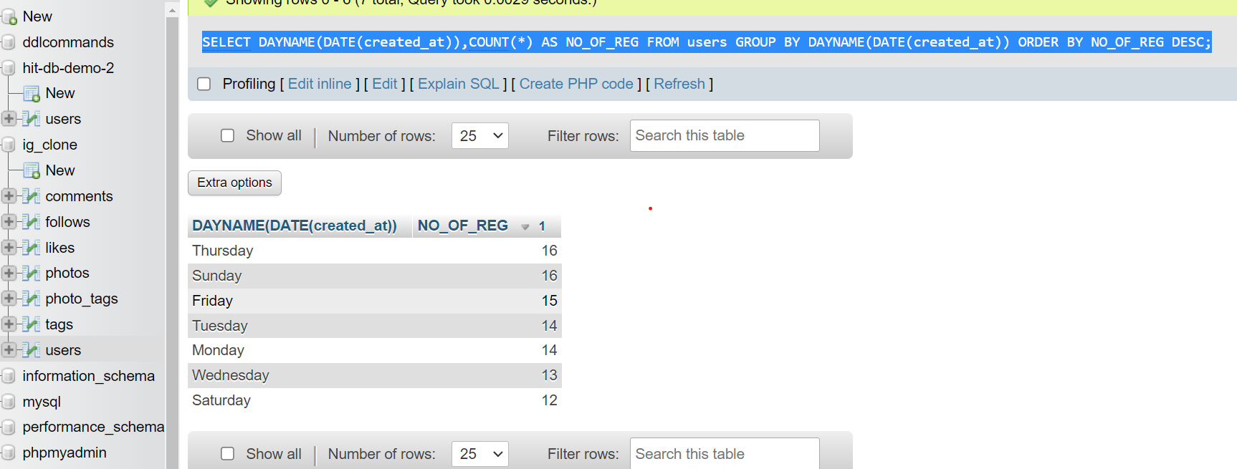
What day of the week do most users register on? Provide insights on when to schedule an ad campaign
SELECT DAYNAME(DATE(created_at)),COUNT(*) AS NO_OF_REG FROM users GROUP BY DAYNAME(DATE(created_at)) ORDER BY NO_OF_REG DESC;

Slide 12
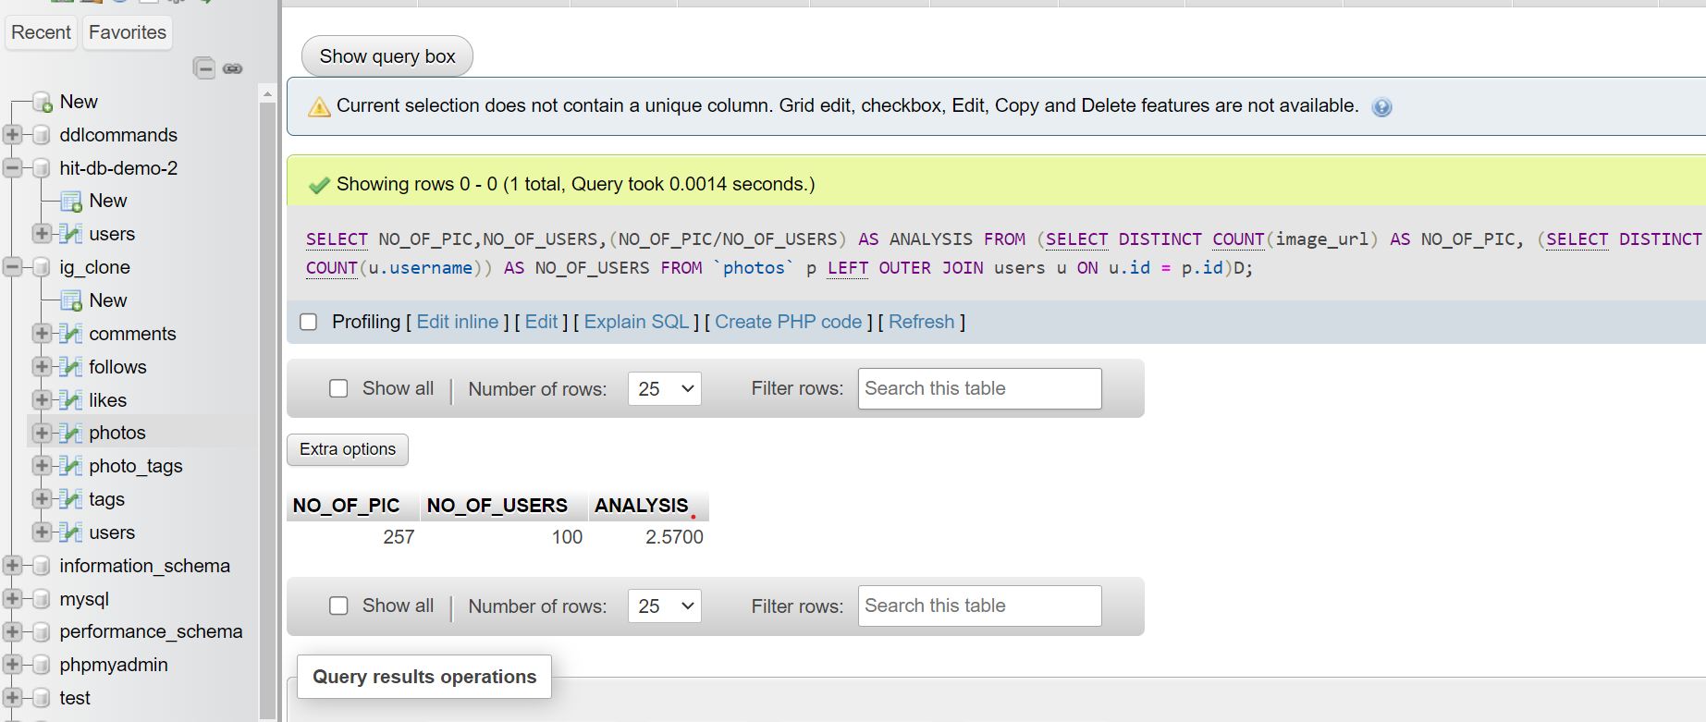
Provide how many times does average user posts on Instagram. Also, provide the total number of photos on Instagram/total number of users
SELECT NO_OF_PIC,NO_OF_USERS,(NO_OF_PIC/NO_OF_USERS) AS ANALYSIS FROM (SELECT DISTINCT COUNT(image_url) AS NO_OF_PIC, (SELECT DISTINCT COUNT(u.username)) AS NO_OF_USERS FROM `photos` p LEFT OUTER JOIN users u ON u.id = p.id)D;

Slide 13
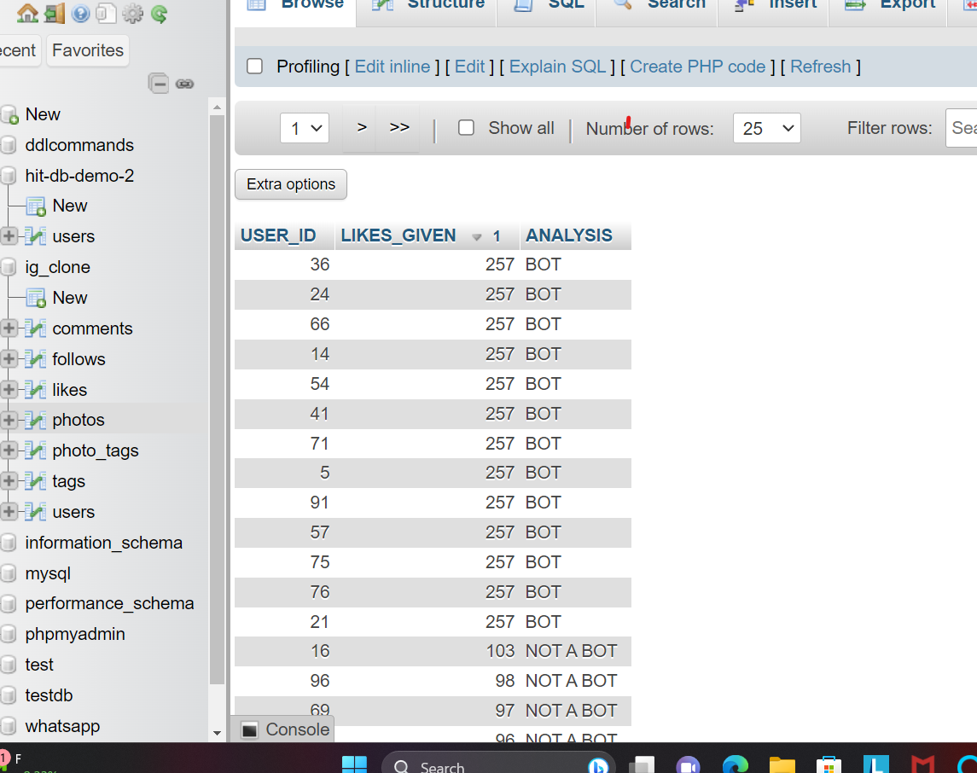
Provide data on users (bots) who have liked every single photo on the site (since any normal user would not be able to do this).

Slide 14
Provide data on users (bots) who have liked every single photo on the site (since any normal user would not be able to do this).
SELECT USER_ID , LIKES_GIVEN,
CASE
WHEN LIKES_GIVEN = NO_OF_IMAGES THEN "BOT"
WHEN LIKES_GIVEN < NO_OF_IMAGES THEN "NOT A BOT"
END AS ANALYSIS
FROM (SELECT COUNT(*) AS LIKES_GIVEN , l.user_id AS USER_ID ,(SELECT COUNT(image_url) FROM photos ) AS NO_OF_IMAGES
FROM likes l
LEFT OUTER JOIN
photos p ON p.id = l.user_id
GROUP BY l.user_id)D
ORDER BY `D`.`LIKES_GIVEN` DESC

Slide 15
THANK YOU

